Slide 1
abstraction
“never write the same thing twice”
that’s too strong, but…
Good programmers hate to see the same code twice
makes for more code
makes for more bugs
makes for more inconsistencies
When we see a pattern
we want to develop an abstraction of the pattern
abstraction is a verb and a noun

Slide 2
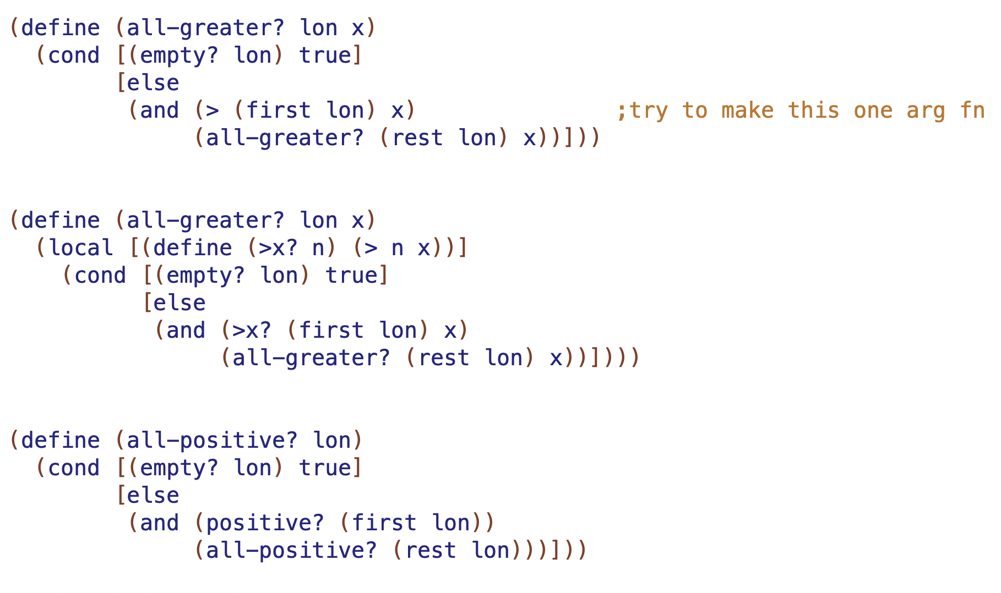

Slide 4
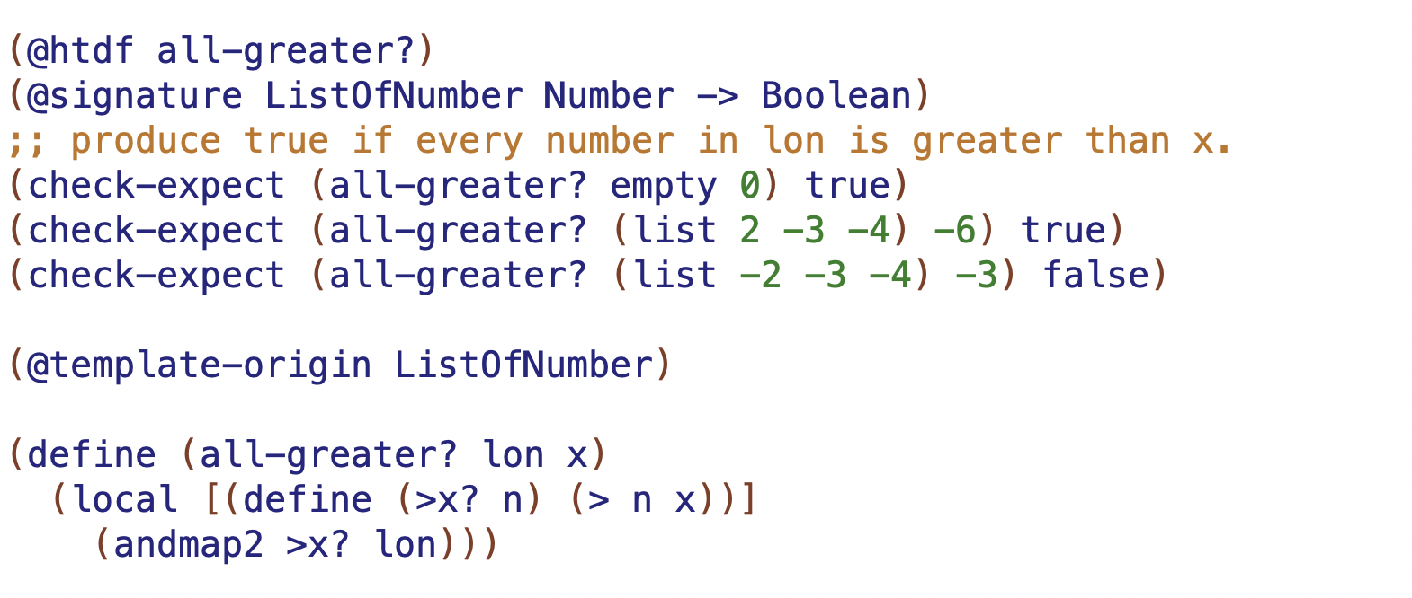
>n? is called a closure
it “closes over” the parameters and local defines in it’s scope

Slide 5
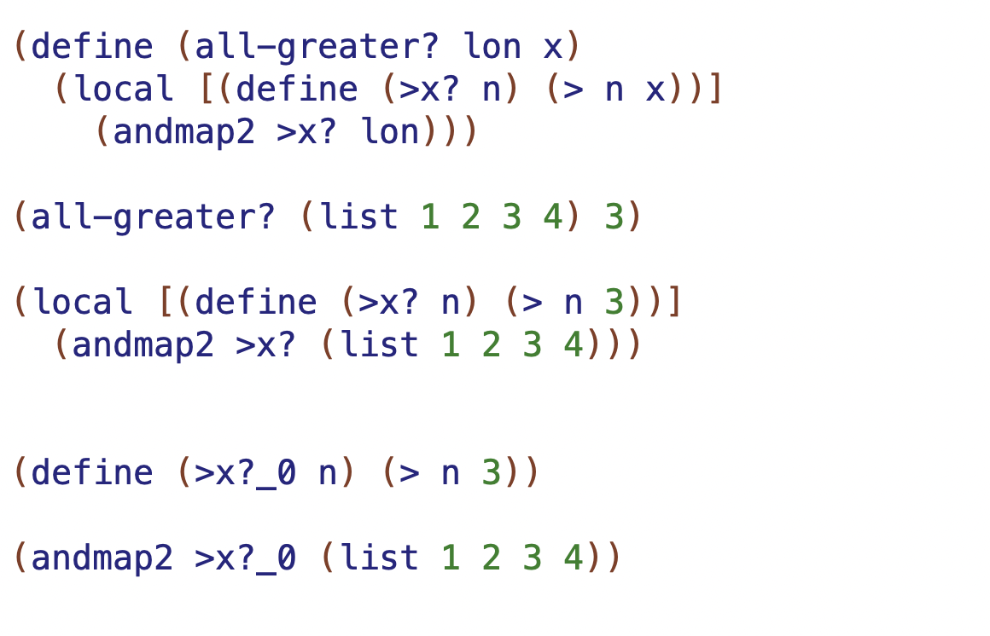
function call replaces n and lon w 3 and (list 1 2 3)
local, renames and lifts
result is unique copy of >n? that closes over n=3

Slide 6
3 new type expressions
(listof <any-type>) ;means ListOfAnyType
;no need to do the data definition
X, Y, Z ... ;type parameters
;one letter, starting at X
;can be any type, BUT all X in a
;given signature are same type
(<type> ... -> <type>) ;a function signature

Slide 7
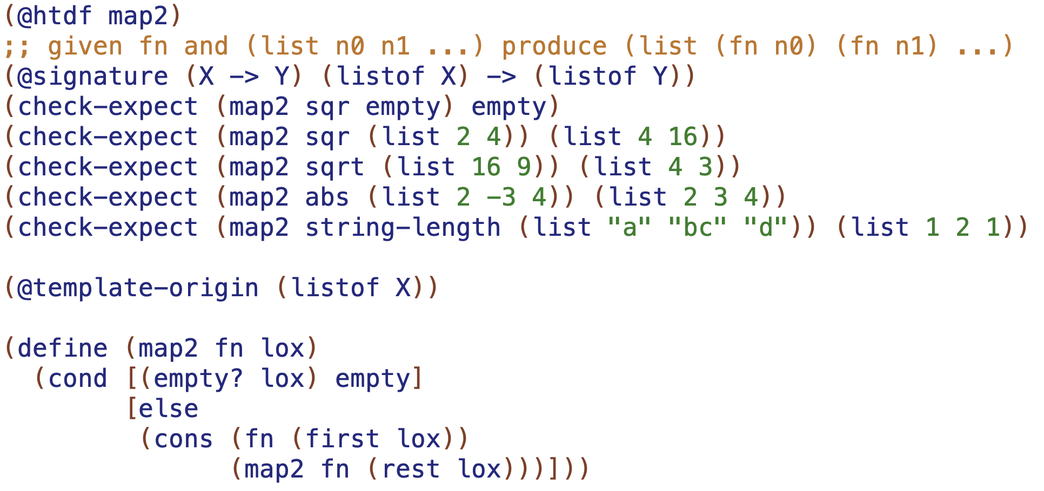
the built-in one is called map

Slide 8
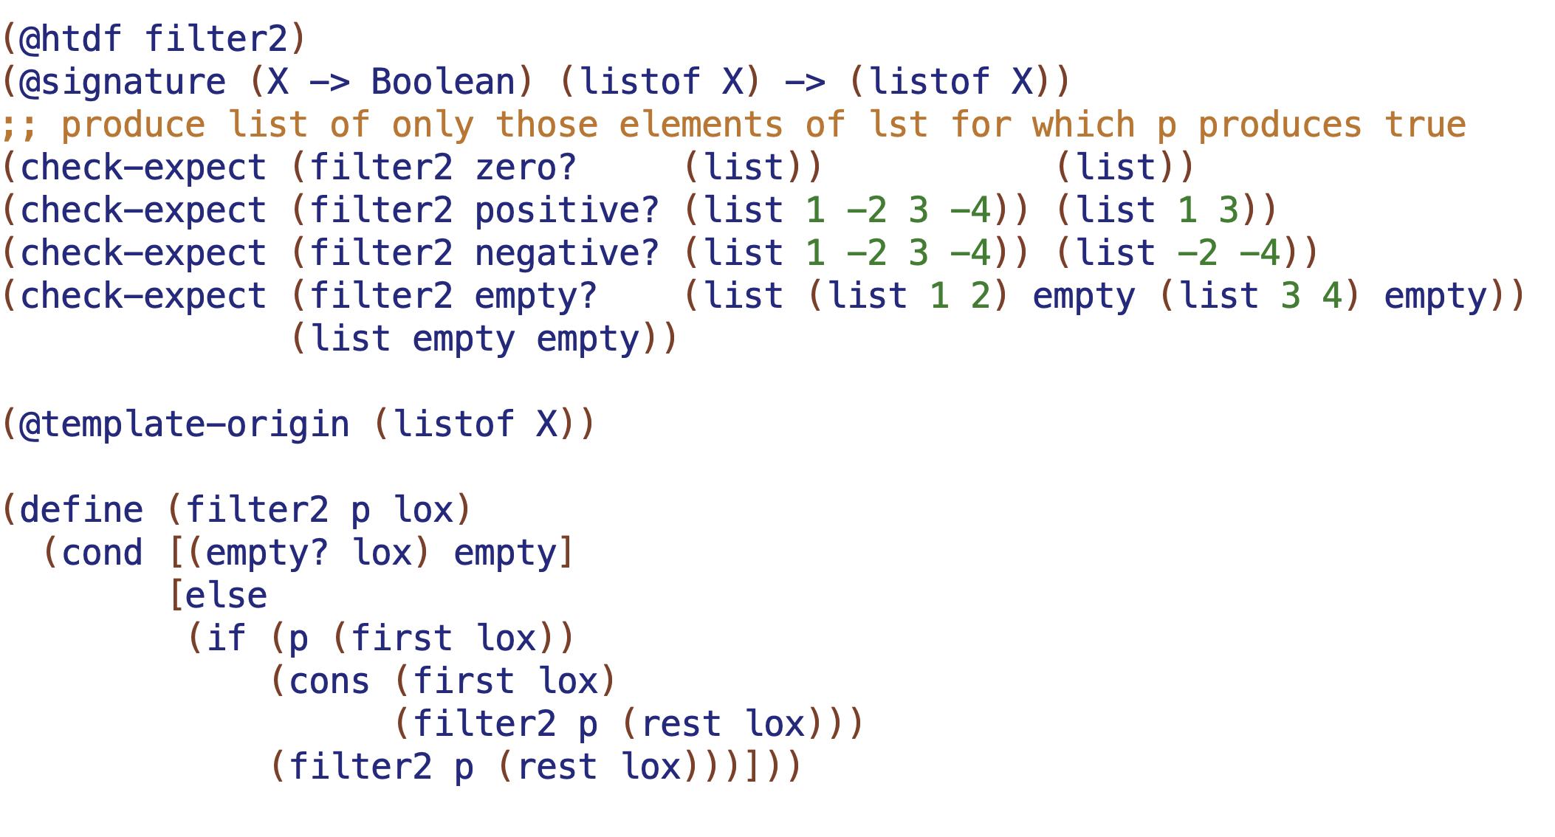
the built-in one is called filter

Slide 9
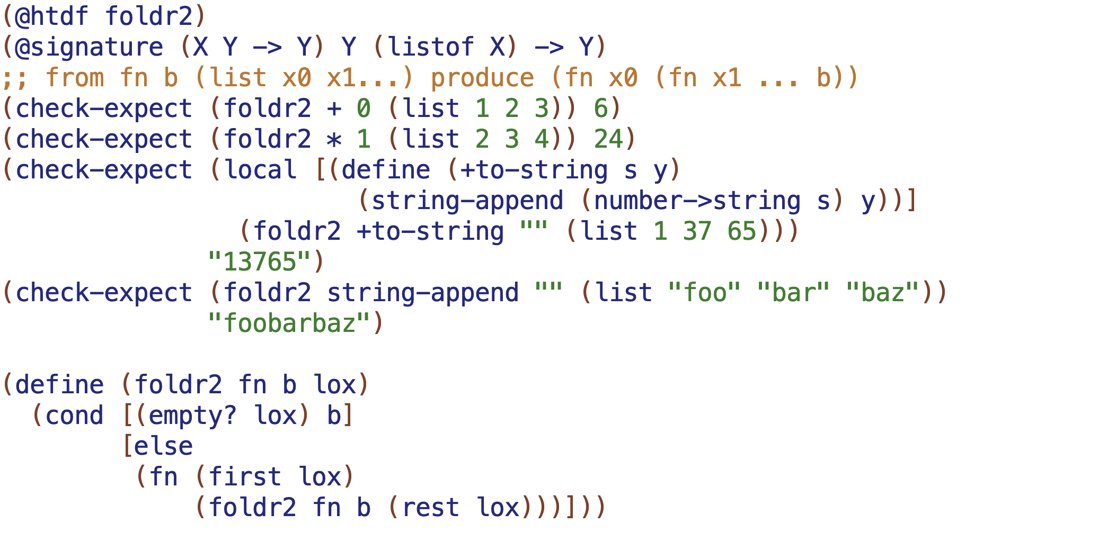
the built-in one is called foldr

Slide 10
built-in abstract functions
links -> language -> end of page
(map fn (list x0 x1 ... xn)) → (list (fn x0) (fn x1) ... (fn xn))
result list has same # elements as argument list
(foldr fn y (list x0 x1 ... xn)) → (fn x0 (fn x1 ... (fn xn y)))
folds argument list down onto result
(filter fn (list x0 x1 ... xn)) → <lst, with only xi for which fn is true>
result list has same elements, possibly fewer
(build-list n fn) → (list (fn 0) (fn 1) ... (fn n-1))
result list of n elements
(andmap fn (list x0 x1 ... xn)) → (and (fn x0) (fn x1) ... (fn xn))
(ormap fn (list x0 x1 ... xn)) → (or (fn x0) (fn x1) ... (fn xn))

Slide 11
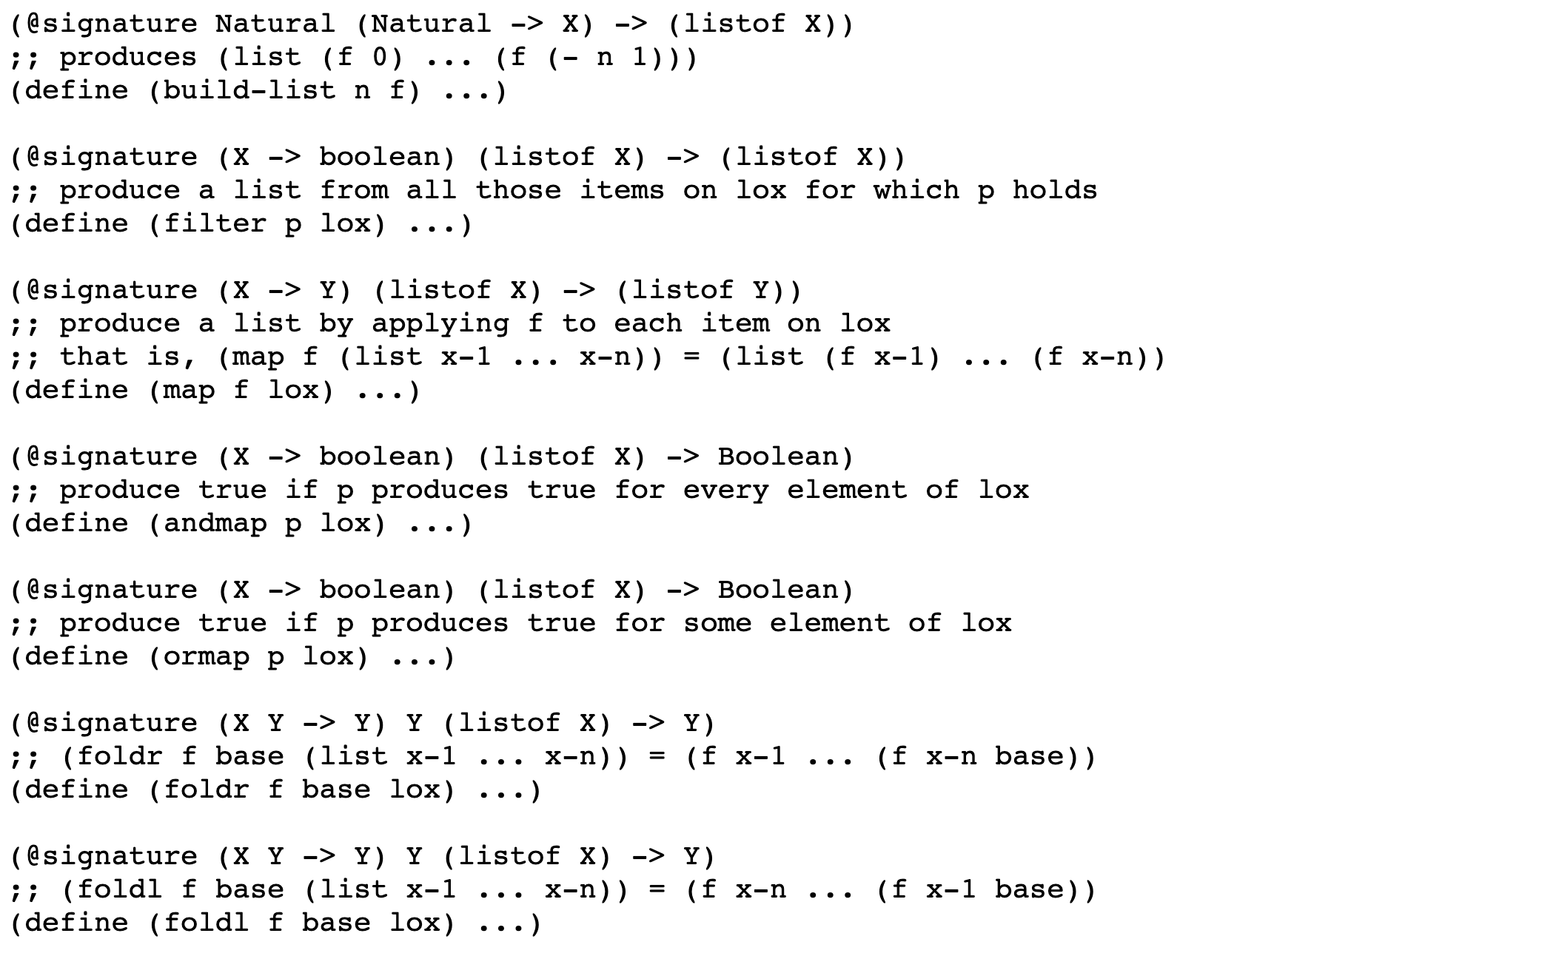
built-in abstract functions
links -> language -> end of page

Slide 12
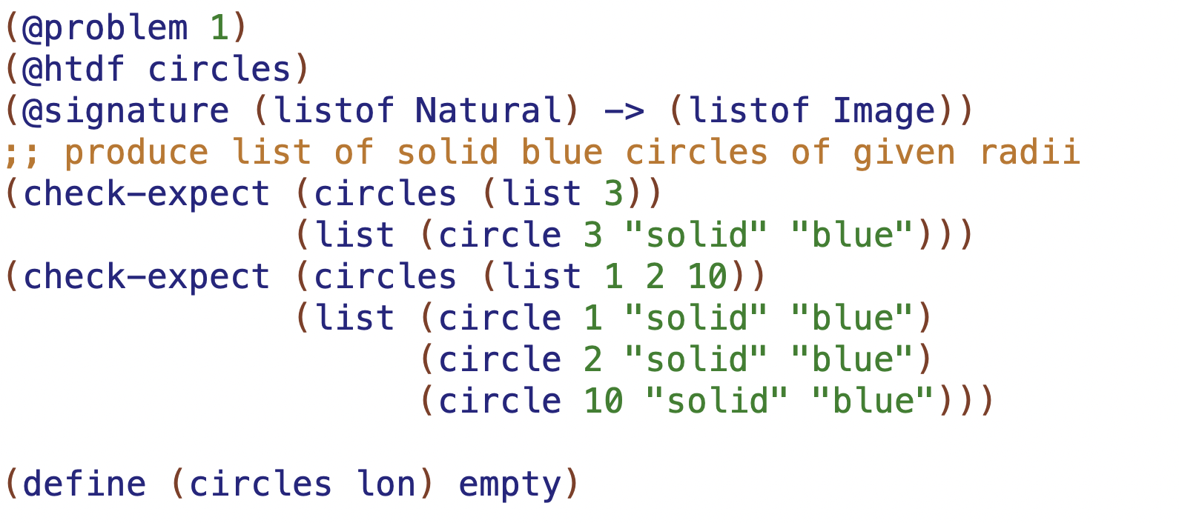

Slide 13
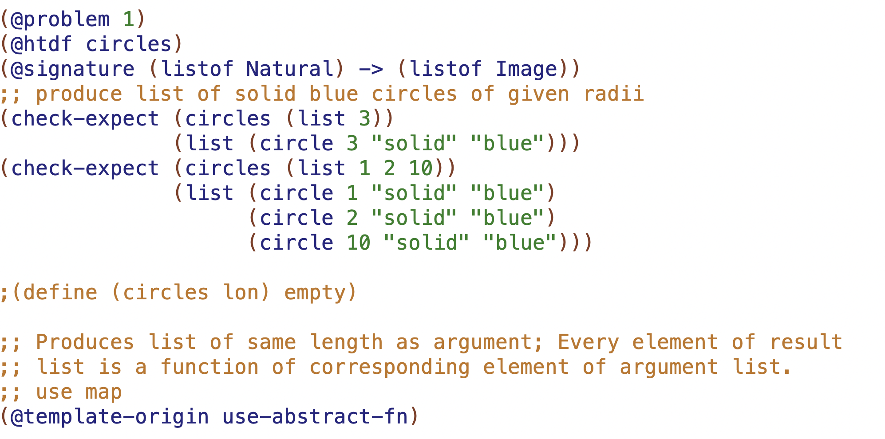

Slide 14
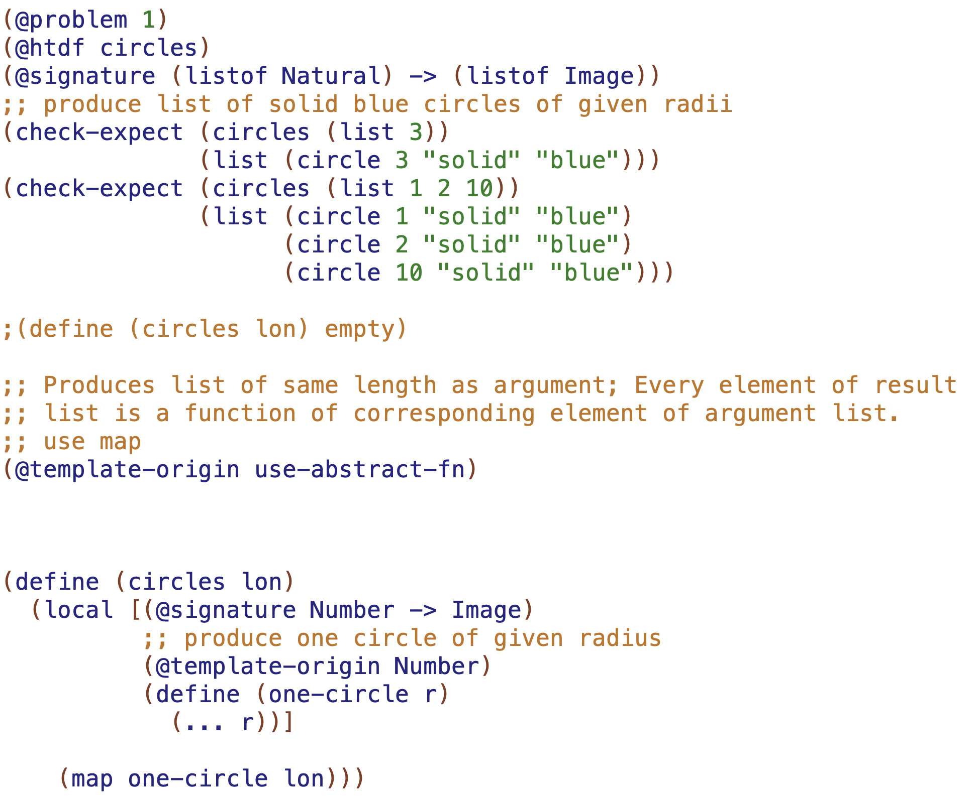

Slide 15
